Slide 1

Automated Attendance System using Face Recognition
Presentation on Minor Project on topic-
Project Guide:
Mr.Vijay Prakash
Ms. Pooja Jain
Mr. Romil Rawat
Presented By:
Aryan Das (16010BTCS00405 )
Ashutosh Sharma (16010BTCS00403)
Falansh Solanki (1601DMTCS0849)

Slide 2
Abstract
The conventional method of taking attendance is done manually by the teacher or the administrator which requires considerable amount of time and efforts also involving errors and proxy attendance.
As the number of students are increasing day by day, it is a challenging task for universities or colleges to monitor and maintain the record of the students.
To overcome these issues, biometric feature like facial recognition can be used which involves the phases such as image acquisition, face detection, feature extraction, face classification, face recognition and eventually marking the attendance.
The algorithms like Viola-Jones and HOG features along with SVM classifier are used to acquire the desired results. Various real time scenarios are needed to be considered such as scaling, illumination, occlusions and pose.
The problem of redundancy in manual records and keeping attendance is solved by this system.

Slide 3
Content
Objective
Concept
Working
Methodology
Viola Jones Algorithm
Face Recognition Approach
System Implementation
Results and Analysis
Pros and Cons
Future Enhancements
Future Scope and Conclusion

Slide 4
Objective
In this project we aim to build an Attendance marking system with the help of facial recognition owing to the difficulty in the manual as well as other traditional means of attendance system

Slide 5
Concept
Automated Attendance System has been envisioned for the purpose of reducing the errors that occur in the traditional (manual) attendance taking system. The aim is to automate and make a system that is useful to the organization such as an institute. The efficient and accurate method of attendance in the office environment that can replace the old manual methods. This method is secure enough, reliable and available for use. No need for specialized hardware for installing the system in the office. It can be constructed using a camera (preferably CCTV) and computer.

Slide 6
Working of our Web Application
Image Capture and Face Detection
Face Recognition by Machine Learning Model
Automated Attendance Feed in Database

Slide 7
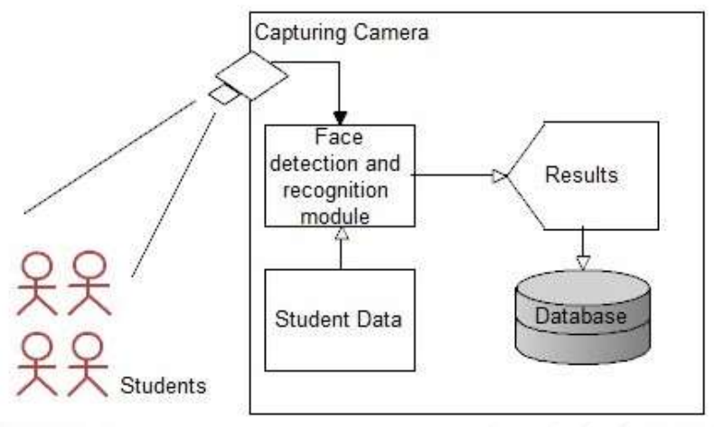
Methodology
Camera captures the image of a classroom
The faces are detected and cropped
Cropped images are processed using Fisher face recognition algorithm
The students whose faces are recognized are marked as present and the results are transferred to an excel sheet automatically.
If any student whose face is not recognized, then their attendance can be entered manually.

Slide 8
Viola-Jones Algorithm
This is used for face detection process
Three basic steps of algorithm
Integral image for feature computation
Adaboost algorithm for feature selection
Cascade classifiers
These are applied directly by OpenCV library.

Slide 9
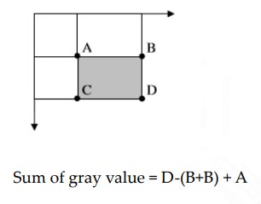
Integral Image Feature Computation
First step of the Viola-Jones face detection algorithm is to turn the input image into an integral image. This is done by making each pixel equal to the entire sum of all pixels above and to the left of the concerned pixel.
Input Image
1 1 1
1 1 1
1 1 1
Integral Image
1 2 3
2 4 6
3 6 9

Slide 10
Adaboost Algorithm
AdaBoost is a machine learning boosting algorithm capable of constructing a strong classifier through a weighted combination of weak classifiers. A weak classifier is mathematically described as:
h(x,f,p,t)=1 pf(x)>t
0 else
Where x is a 24*24 pixel sub-window, f is the applied feature, p the polarity and t the threshold that decides whether x should be classified as a positive (a face) or a negative (a non-face)..

Slide 11
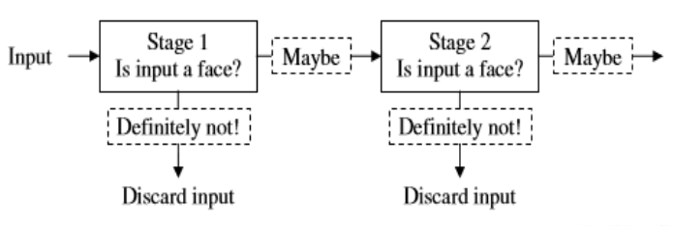
Cascade Classifiers
Instead of finding faces, the algorithm discards those inputs, which are not faces.

Slide 12
Face Recognition Approach: FisherFace
Face is a typical multidimensional structure and needs good computational analysis for recognition.
Many face features make development of facial recognition systems difficult.
This problem is solved by the method called Principal Component Analysis or so called fisher face approach.
This approach transforms faces into a small set of essential characteristics, fisherfaces, which are the main components of the initial set of learning images (training set).
Recognition is done by projecting a new image in the fisherface subspace, after which the person is classified by comparing its position in fisherface space with the position of known individuals.

Slide 13
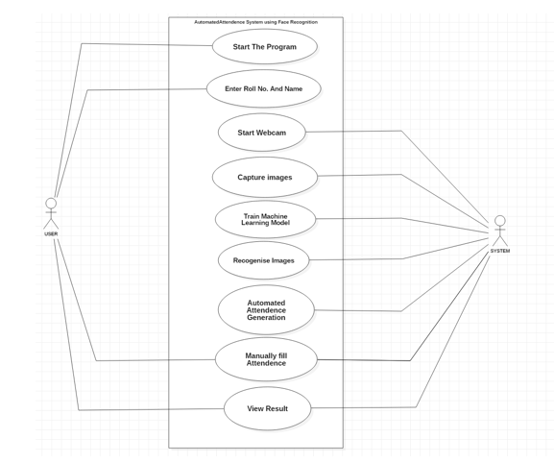
System Implementation
Use Case Diagram

Slide 14
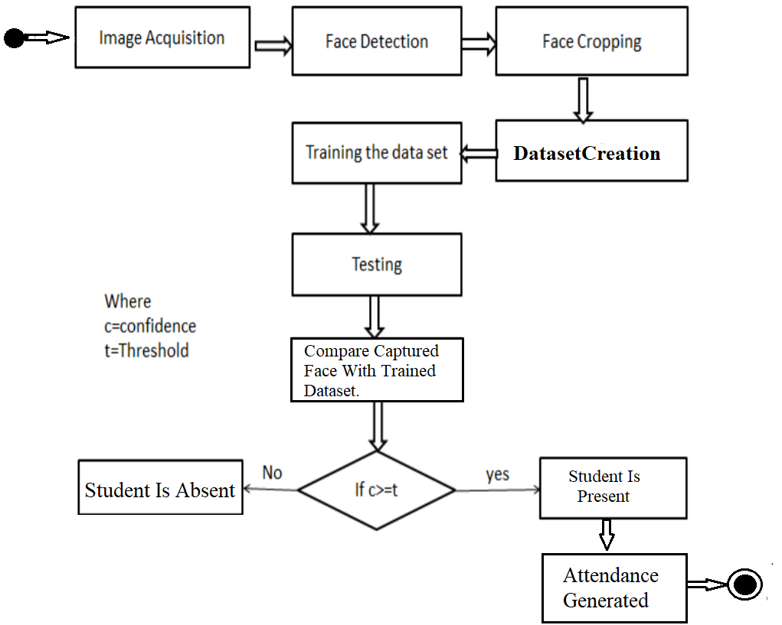
System Implementation
Activity Diagram

Slide 15
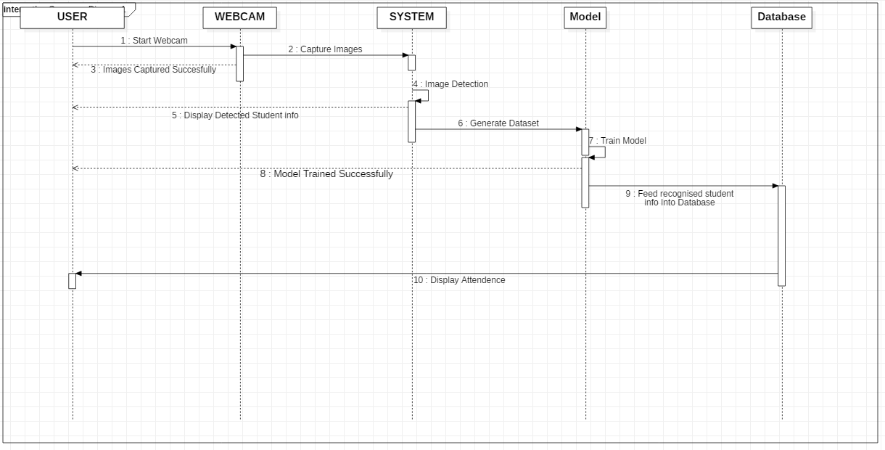
System Implementation
Sequence Diagram

Slide 16
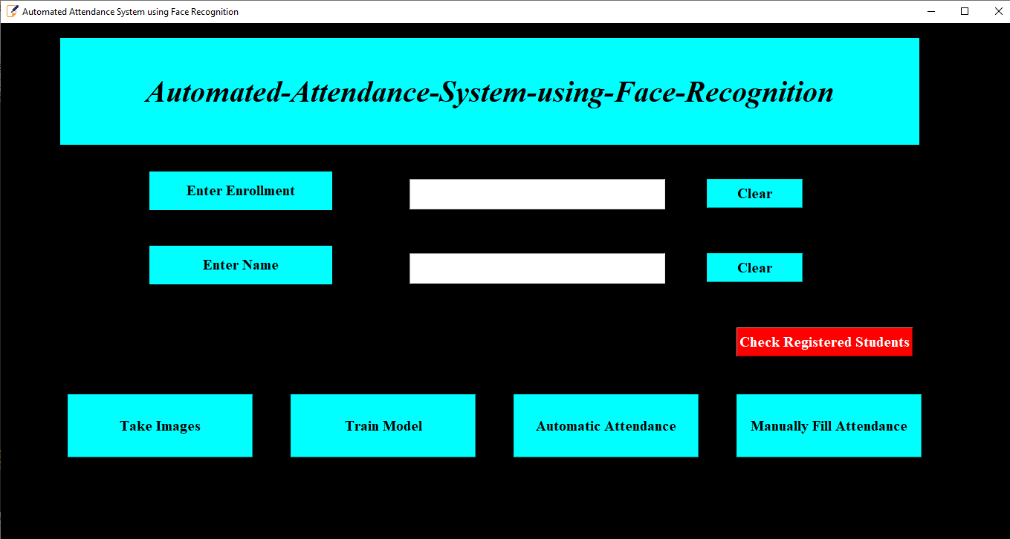
Results and Analysis
Graphical User Interface

Slide 17
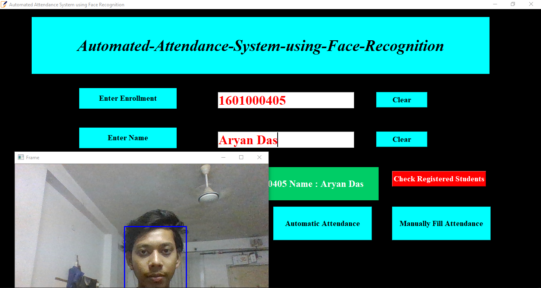
Results and Analysis
Image Capturing, Face Detection and Image Cropping for the entered Enrollment No & Name

Slide 18
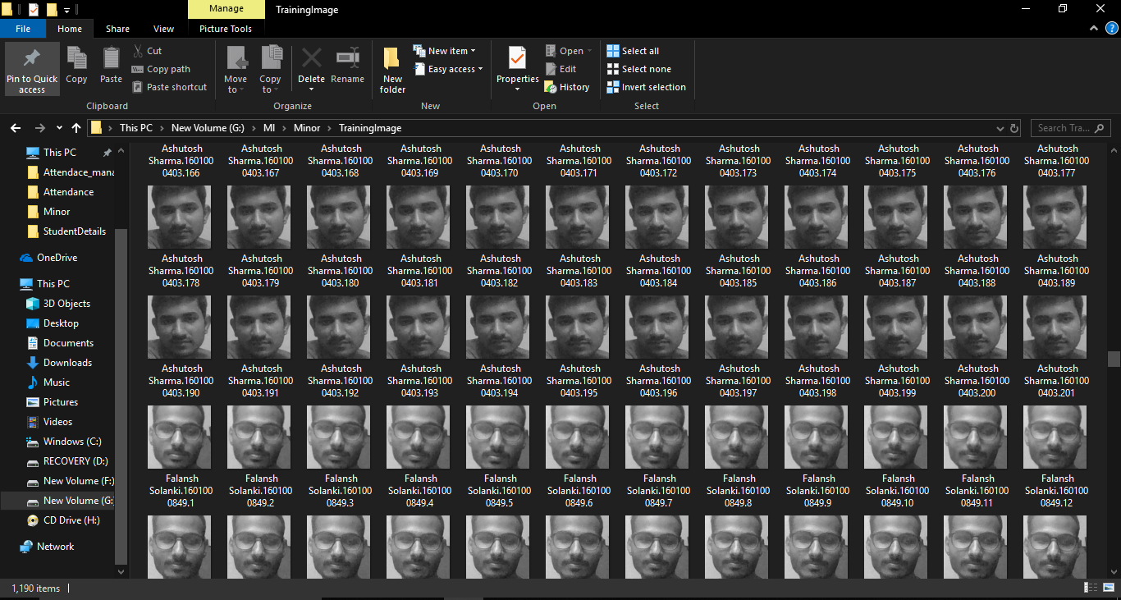
Results and Analysis
Generated Datasets

Slide 19
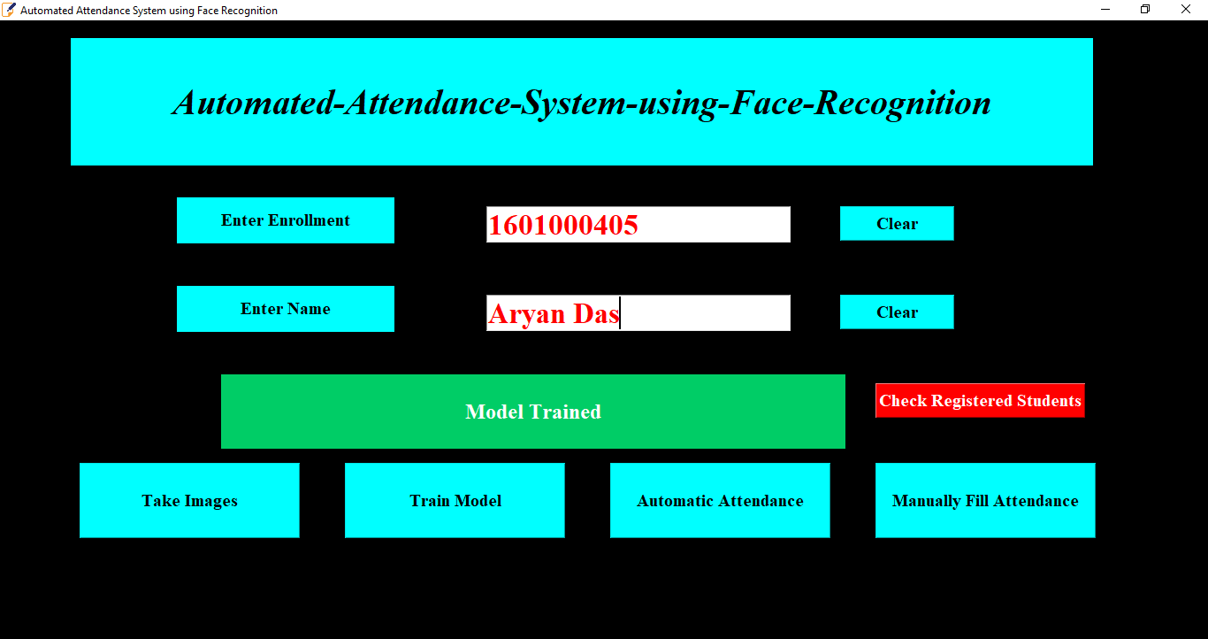
Results and Analysis
Training the Model on the generated dataset

Slide 20
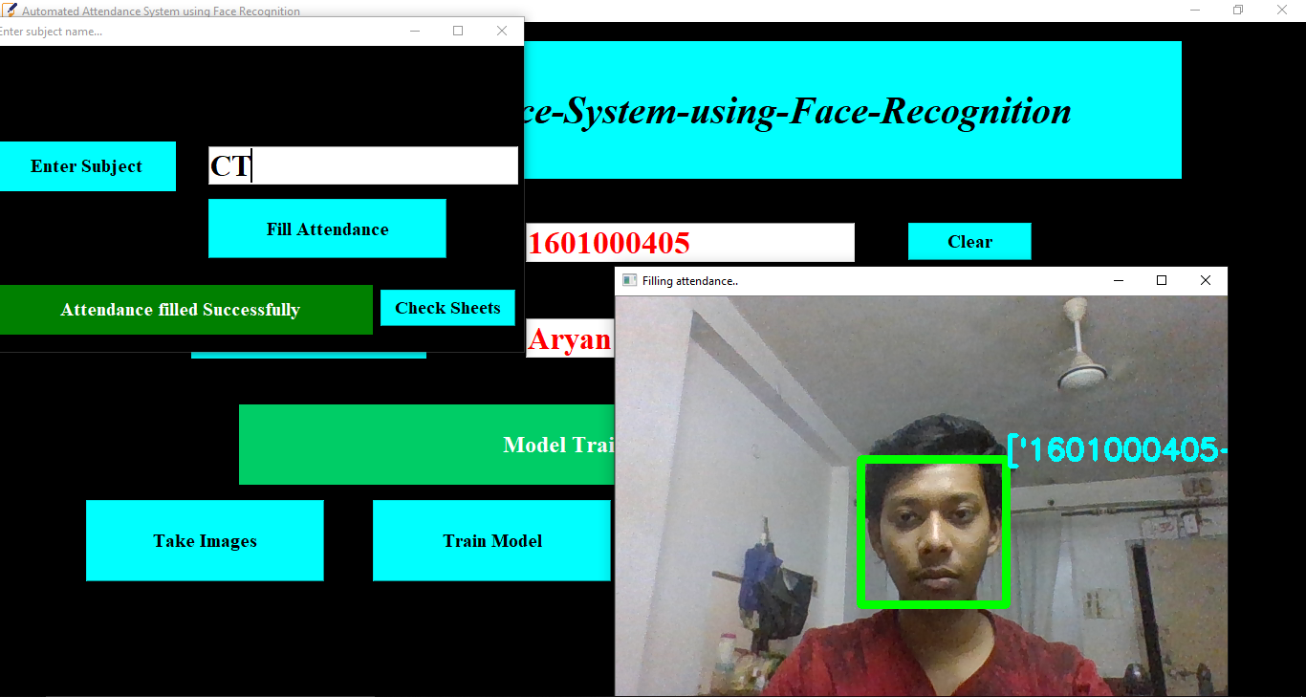
Results and Analysis
Automated Attendance Generation

Slide 21
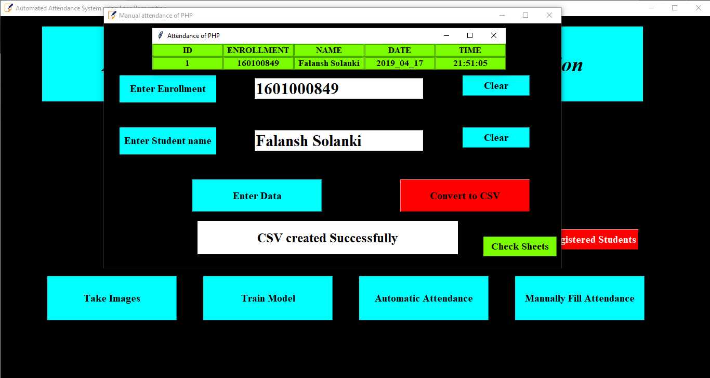
Results and Analysis
Manual Attendance Addition for Unrecognized faces

Slide 22
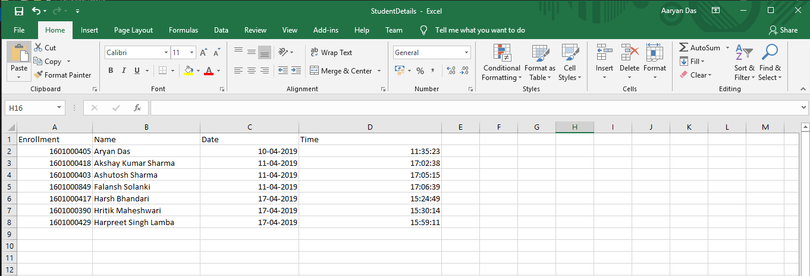
Results and Analysis
Generated Attendance Output in MS Excel

Slide 23
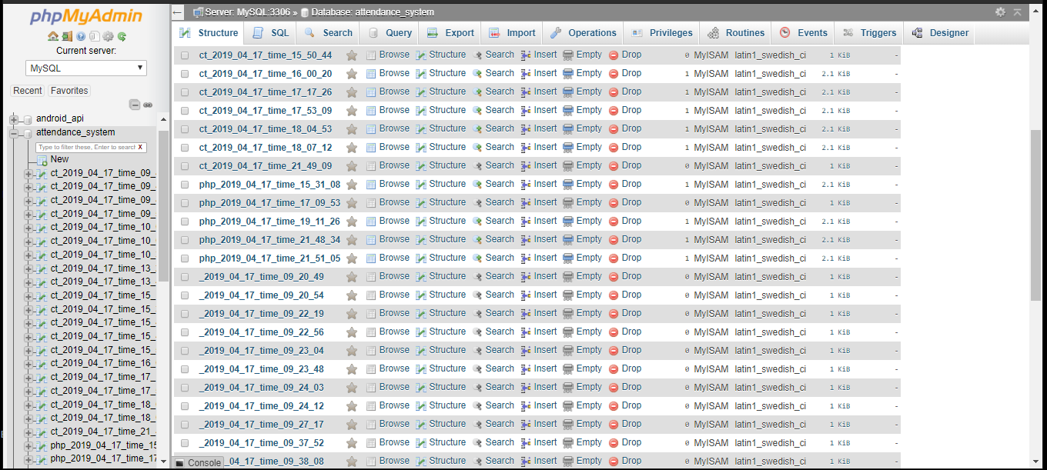
Results and Analysis
Automated Attendance Feed in Database

Slide 24
Pros and Cons
Pros
Easy integration
Simple algorithm
Easy to use output format
Proxy attendance is eliminated
Saves time
Cons
Sensitive to lighting variations
Distance required for detection from camera is short
Booting Time of Web App is High

Slide 25
Future Enhancement Suggestions
The speed can be further enhanced .
The distance limit up to which the camera would be able to recognize faces can be increased.
The data set used to train the model can be further improvised by adding more samples corresponding to each face. This would increase the accuracy.

Slide 26
Future Scope
The system we have developed has successfully able to accomplish the task of marking the attendance in the classroom automatically and output obtained in an excel sheet as desired in real time. Another important aspect where we can work is towards creating an online data base of the attendance and its automatic updating, keeping in mind growing popularity of internet of things.

Slide 27
Conclusion
In the system we have implemented an attendance system for a lecture, section or laboratory by which lecturer or teaching assistant can record student attendance. Its saves time and effort, especially if it is a lecture with huge number of students.

Slide 28
Thanks!

